Slide 1
DataSpark: Illuminating Insights for Global Electronics

Slide 2
Problem Statement
As part of Global Electronics' data analytics team, you are tasked with conducting a comprehensive Exploratory Data Analysis (EDA) to uncover valuable insights from the company’s data. Your goal is to provide actionable recommendations that can enhance customer satisfaction, optimize operations, and drive overall business growth.
Global Electronics, a leading retailer of consumer electronics, has provided you with several datasets containing information about their customers, products, sales, stores, and currency exchange rates. The company seeks to leverage this data to better understand their business and identify areas for improvement.

Slide 3
Datasets
We have 5 datasets:
Customers details
Products details
Sales details
Stores details
Exchange rates

Slide 4
Data Preprocessing & EDA

Slide 5
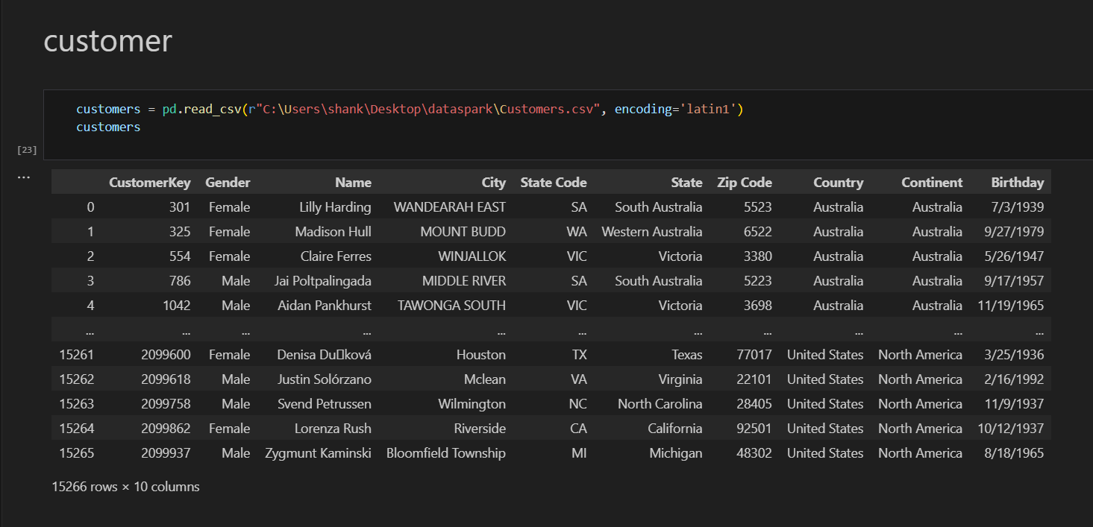
1.Customers Dataset
It has 10 columns and 15266 rows

Slide 6
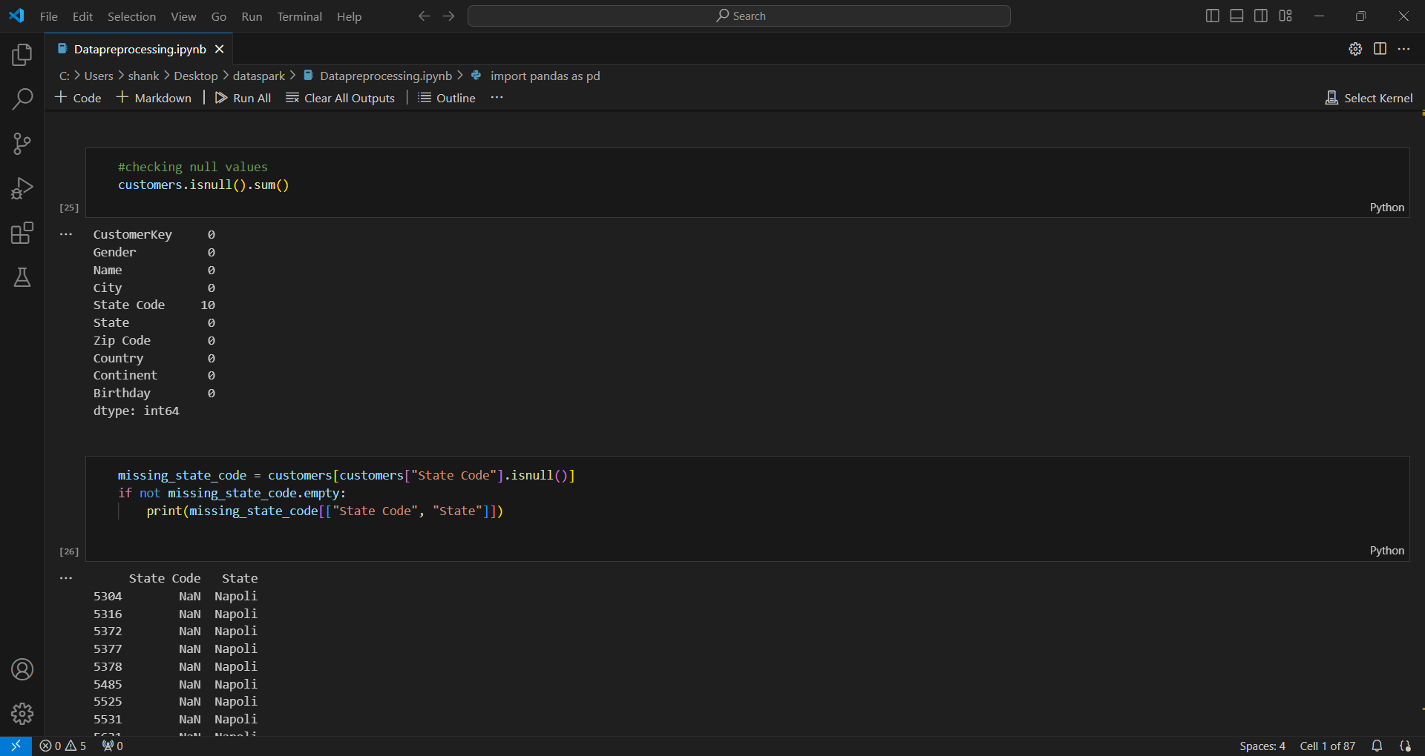
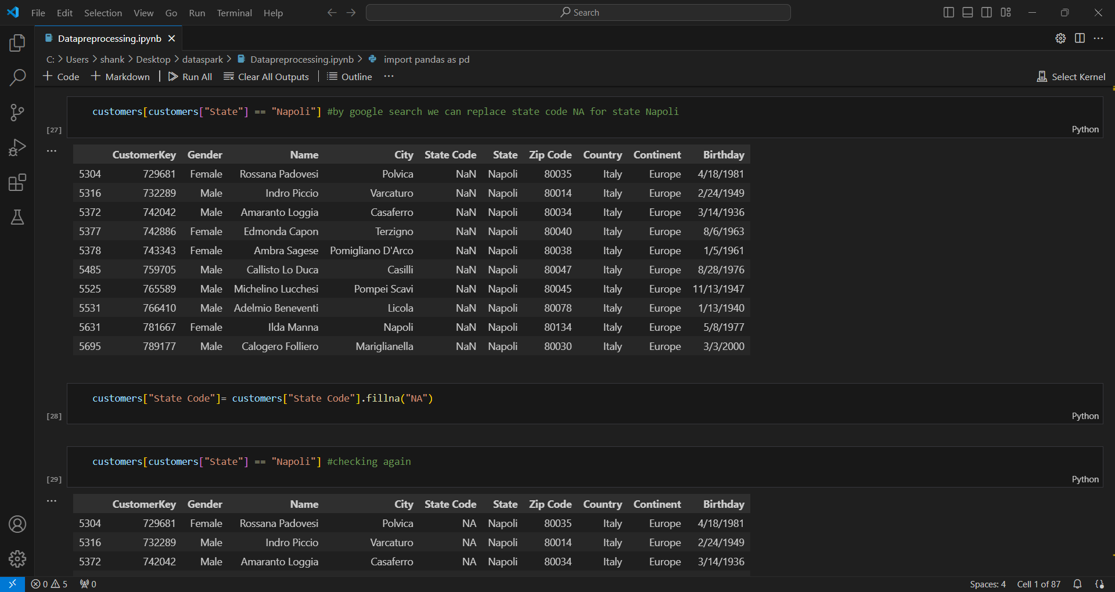
Checking null values
Filled null value column by its respective state code by referring google

Slide 7
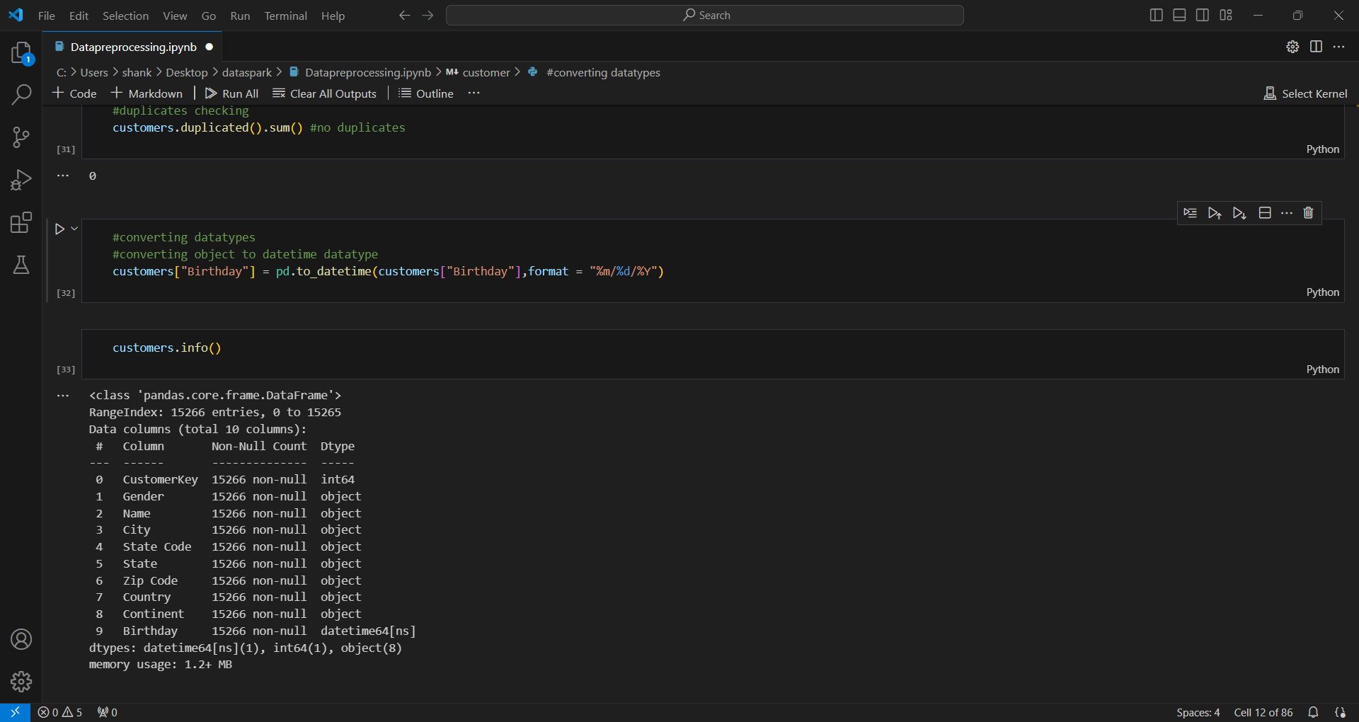
Checking duplicates and changing dtypes
From this customer dataset we don’t have any duplicate values.
Converted birthday column into datetime data types

Slide 8
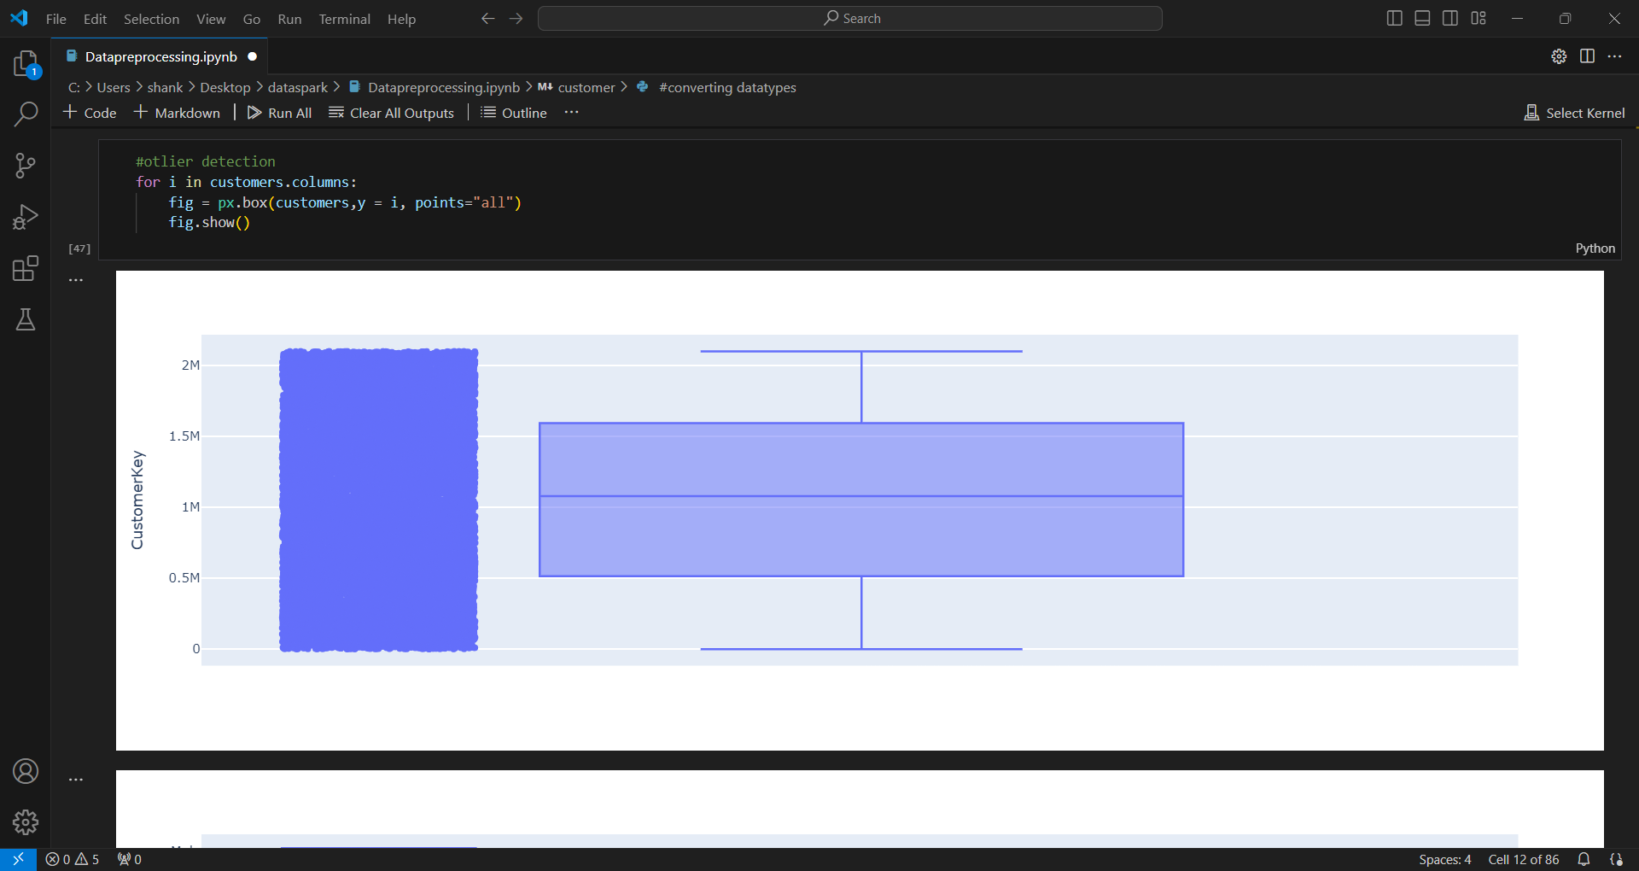
Outliers checking
Outliers checking using box plot. No outliers in this dataset

Slide 9
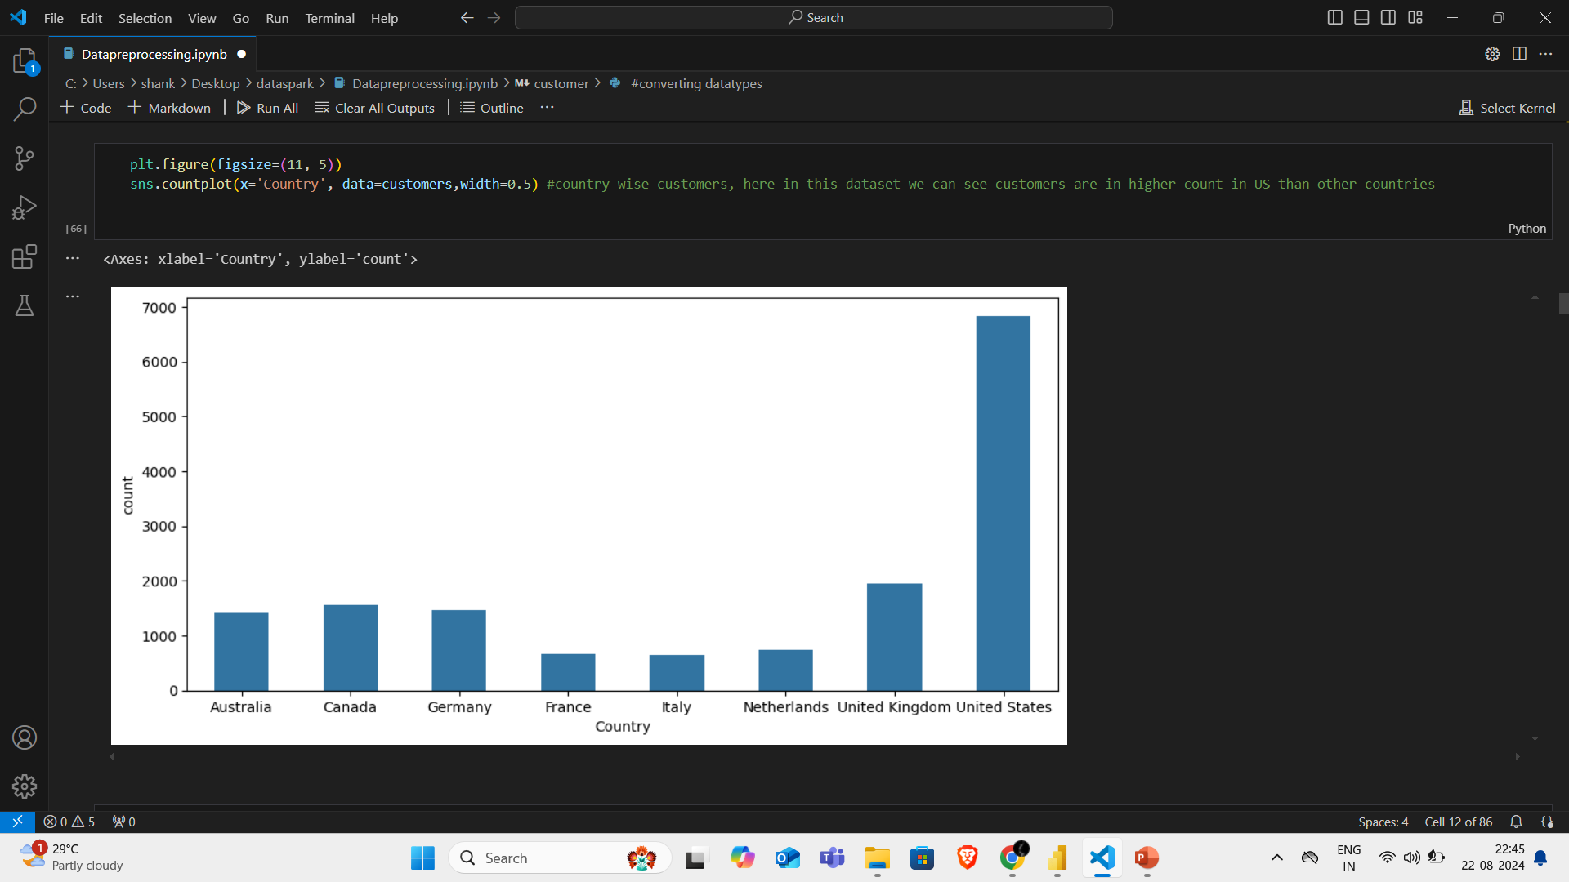
Count plot to analyse categorical column

Slide 10
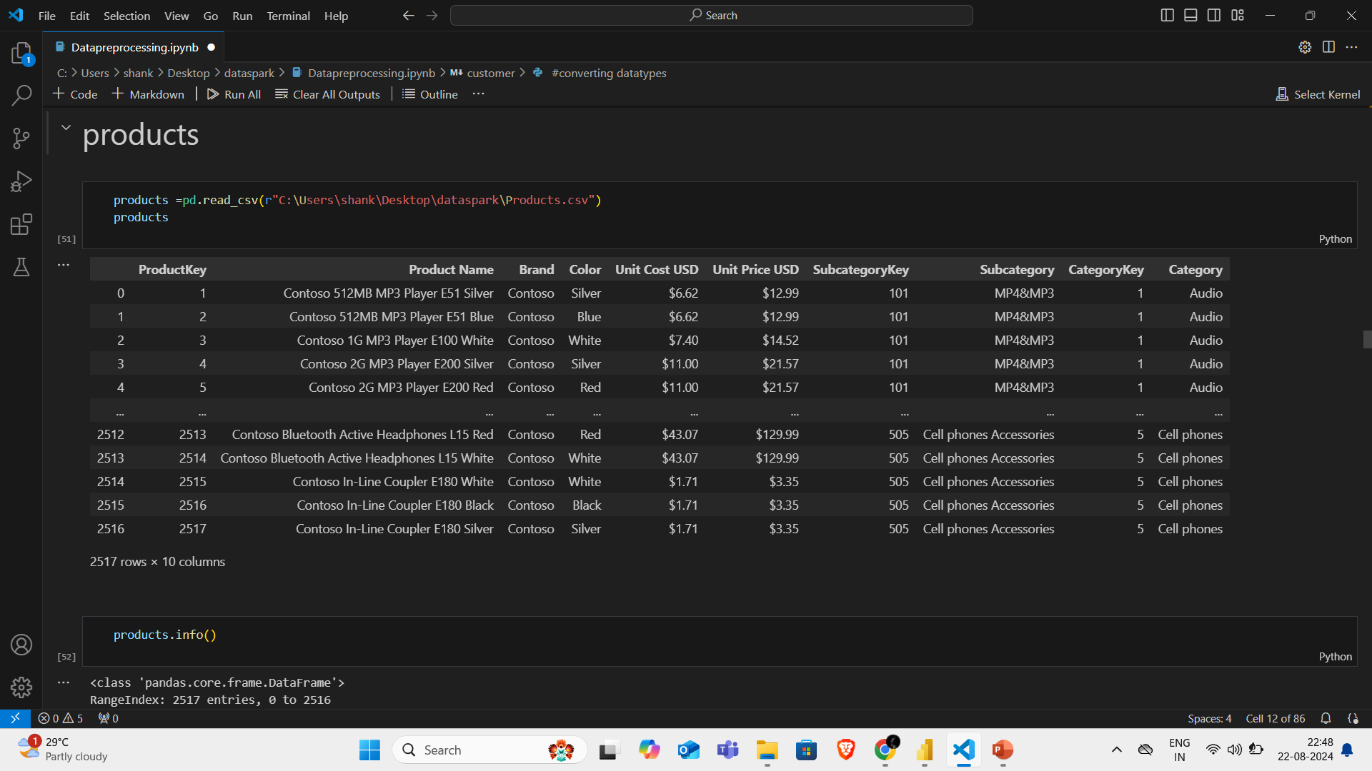
2.Products Dataset
It has 10 columns and 2517 rows

Slide 11
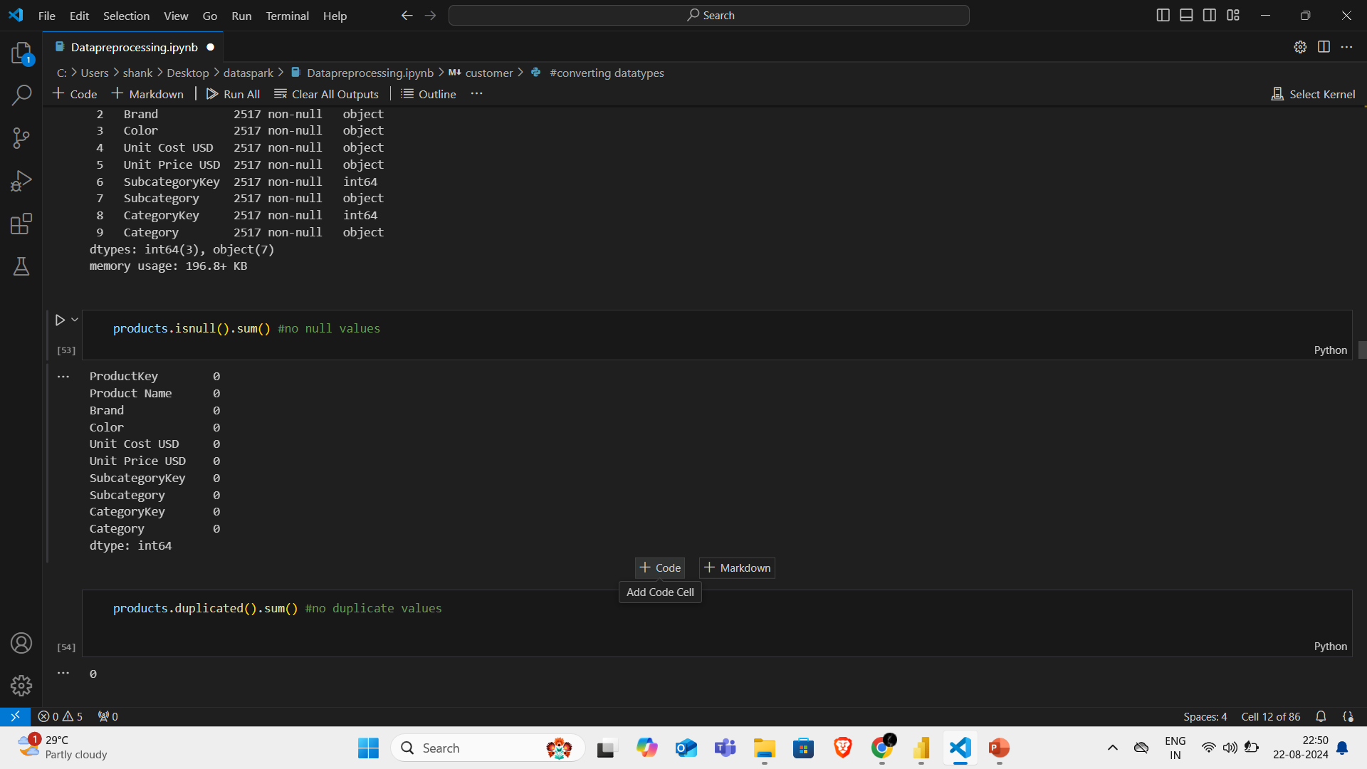
Null & duplicates checking
From this products dataset there is no null and duplicates values

Slide 12
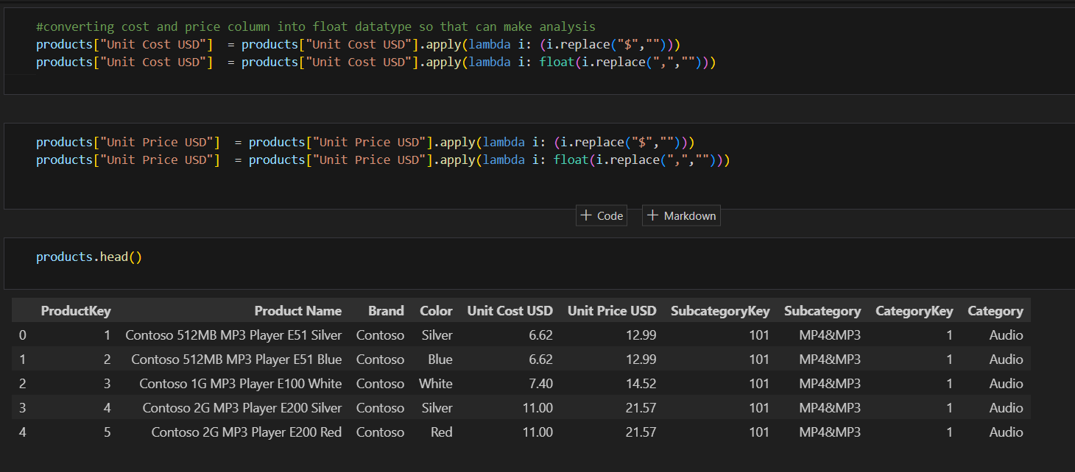
Converting dtypes

Slide 13
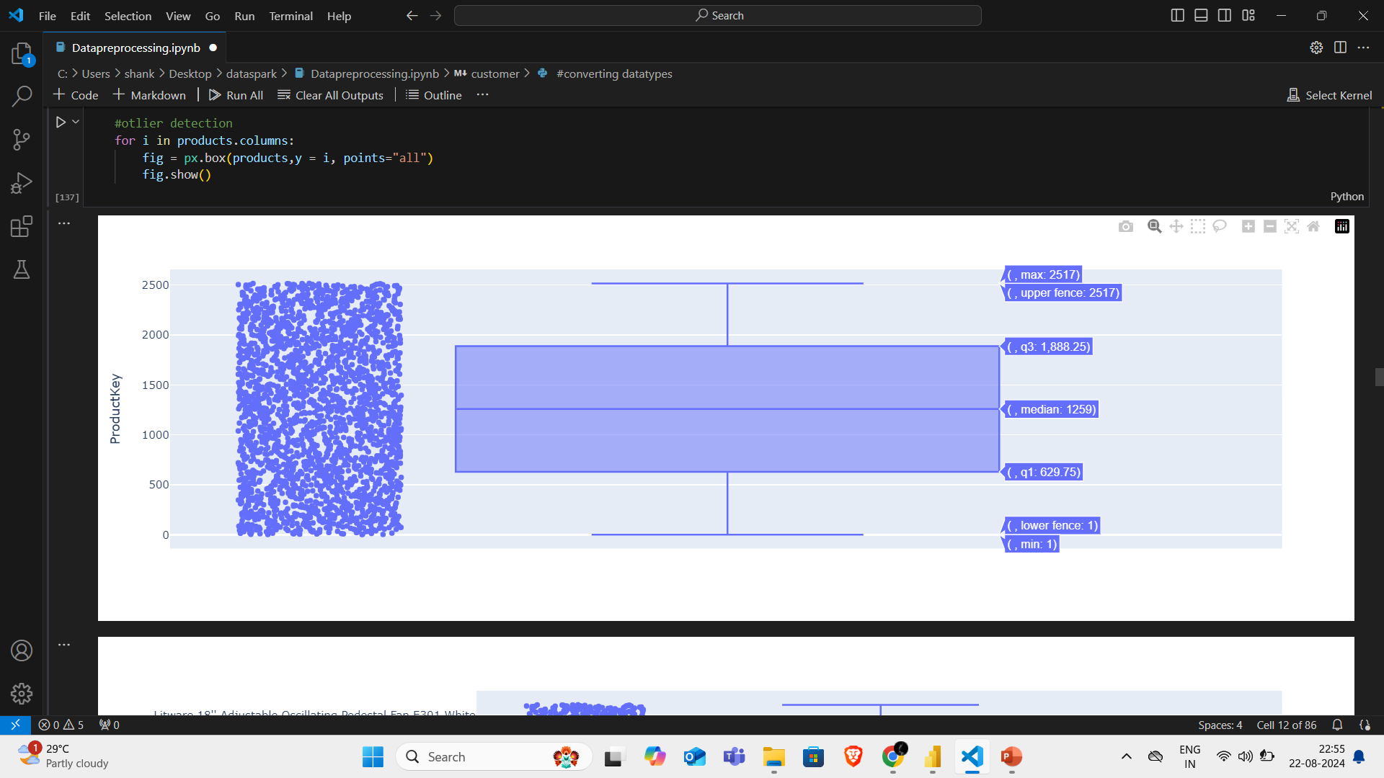
Outliers checking
#in this dataset we have outliers in columns like cost usd and price usd but i consider we dont have to treat this outliers
# cz it depends on the price of the products in may change so in this case this is not a bad outlier

Slide 14
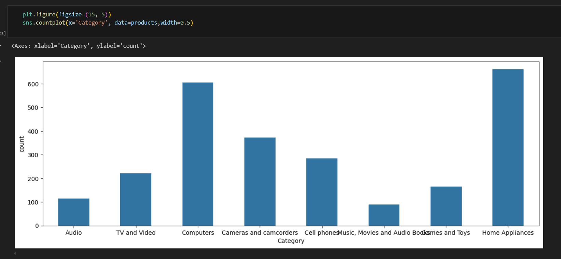
Countplot

Slide 15
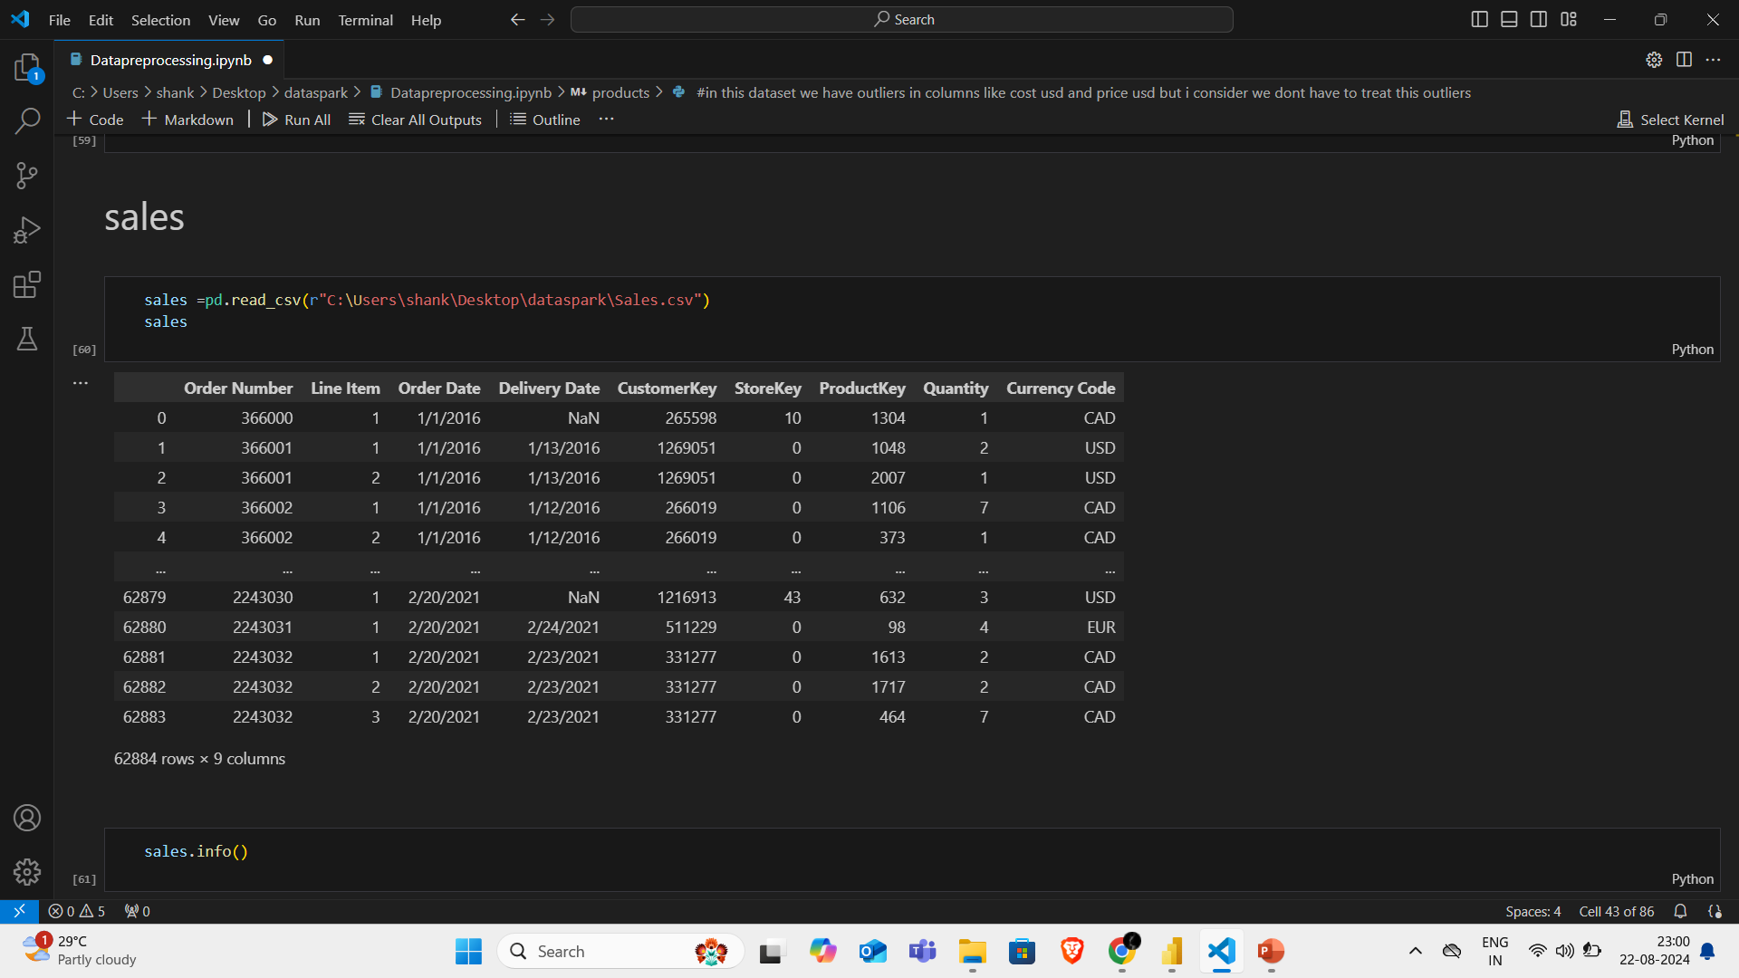
3.Sales dataset
It has 9 columns and 62884 rows

Slide 16
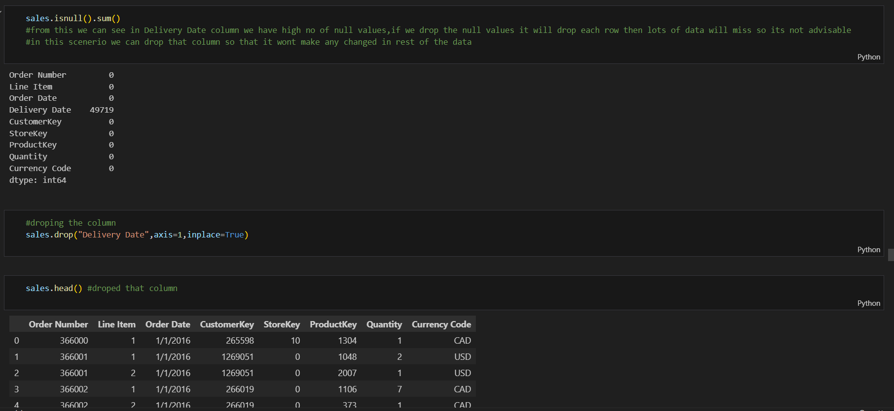
Null & duplicates checking

Slide 17
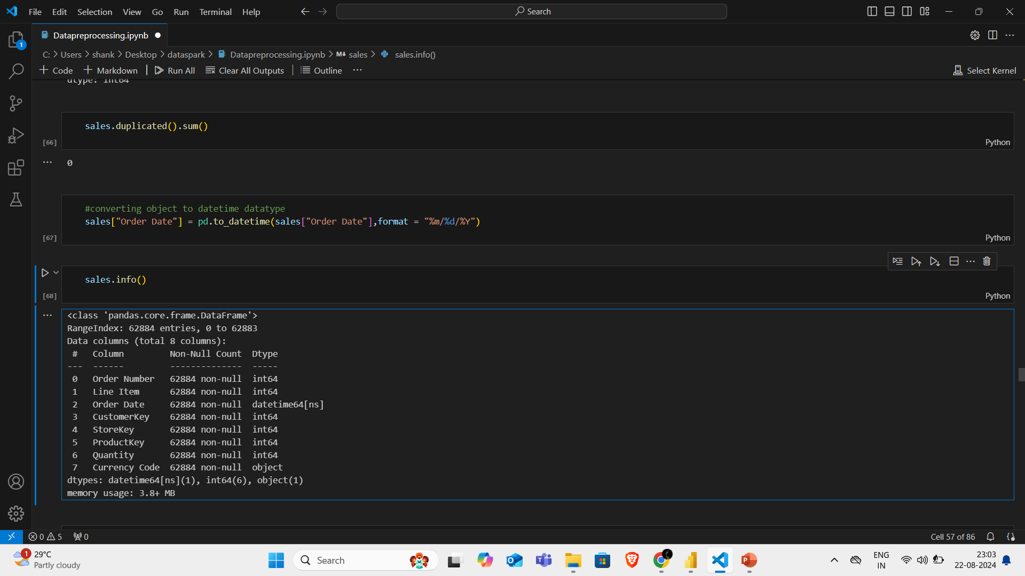
Converting data types
From this customer dataset we don’t have any duplicate values.
Converted order date column into datetime data types

Slide 18
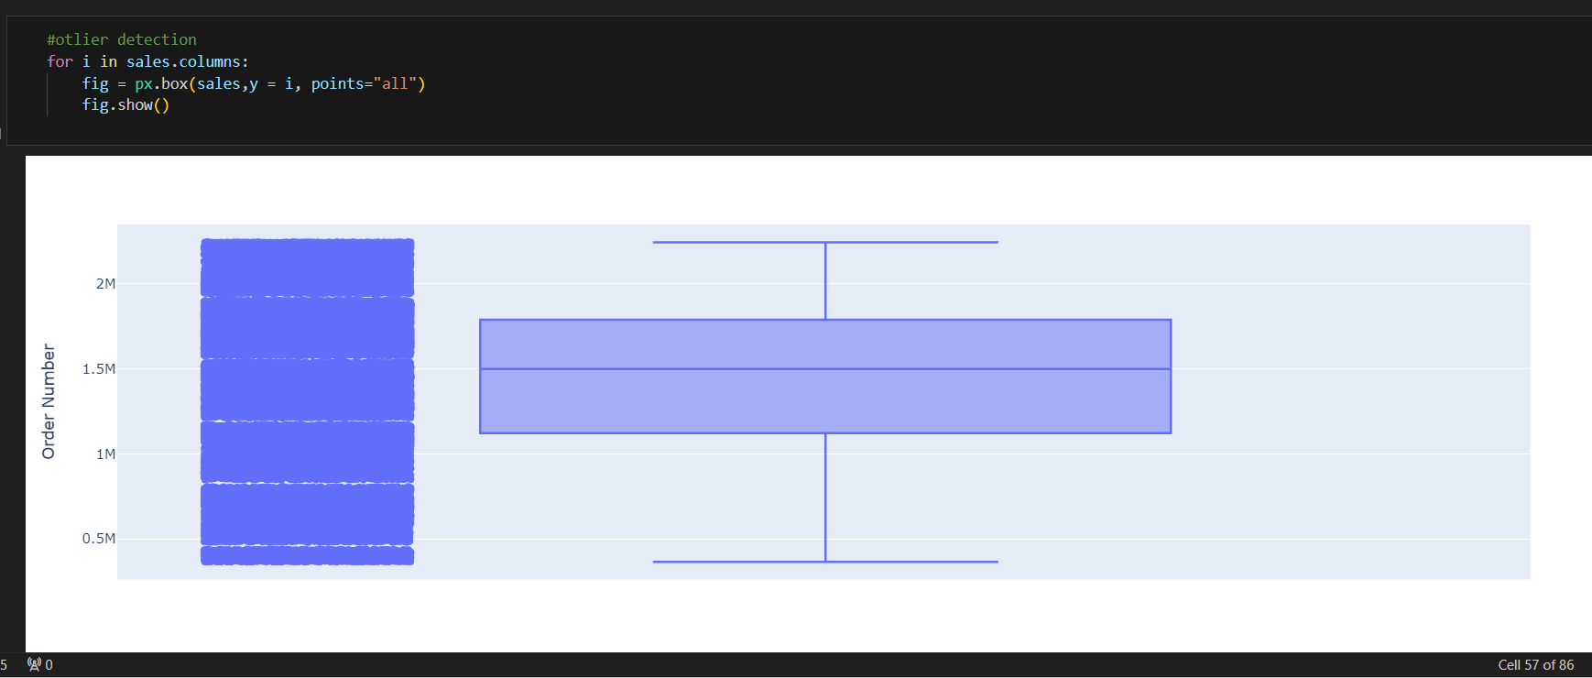
Outlier checking
No treatable outlier in this dataset

Slide 19
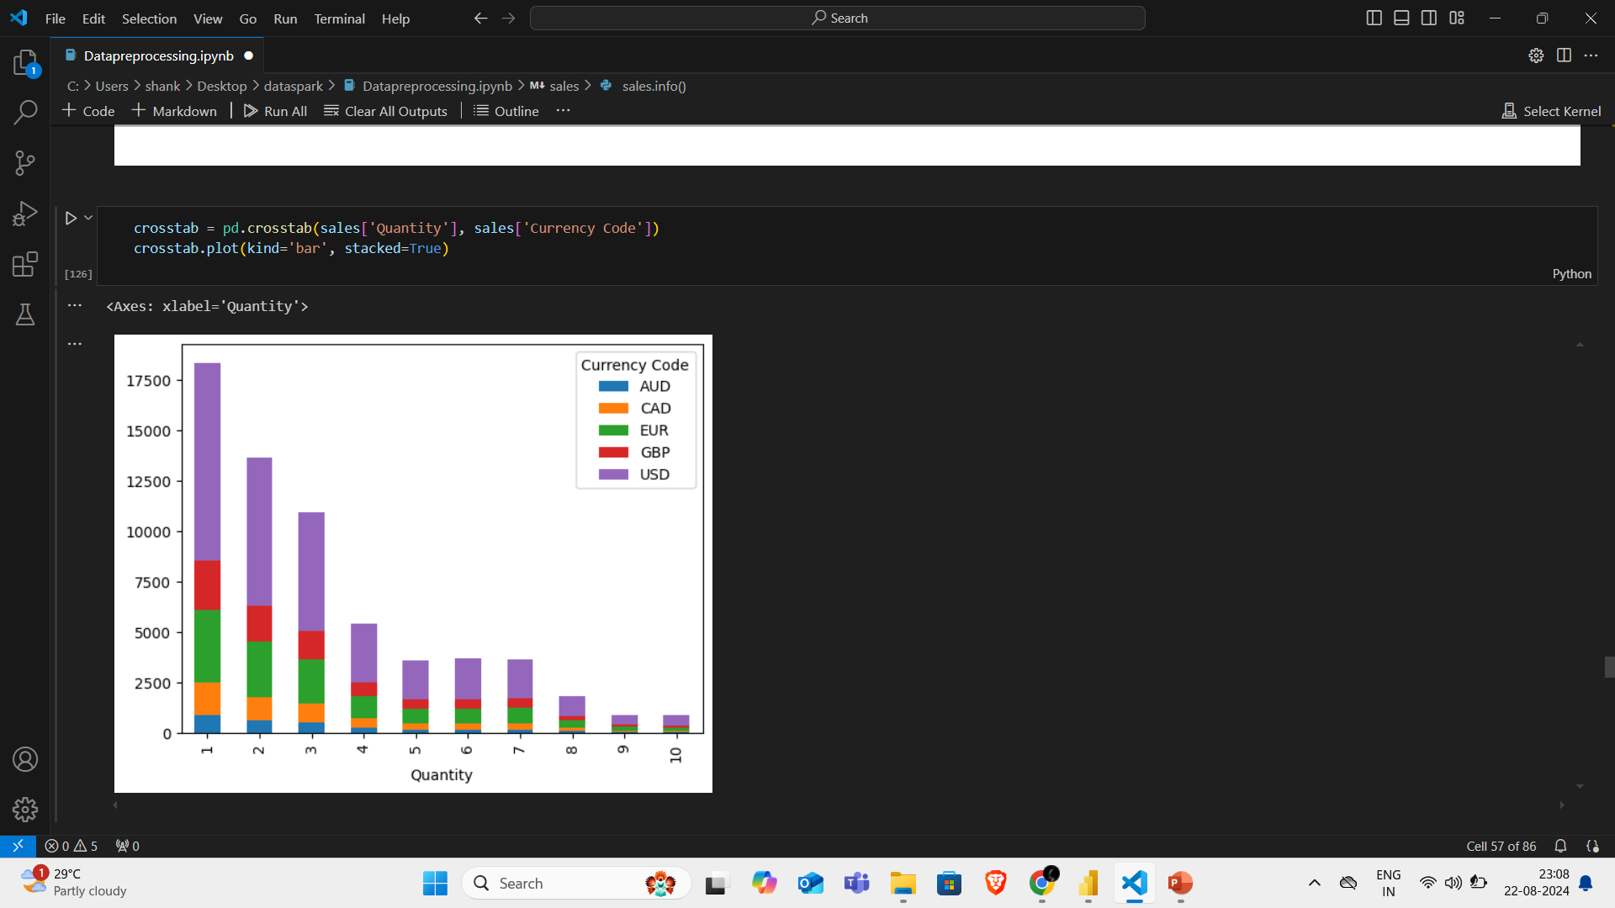
Stacked bar chart
Stacked bar chart to knw the relationship here

Slide 20
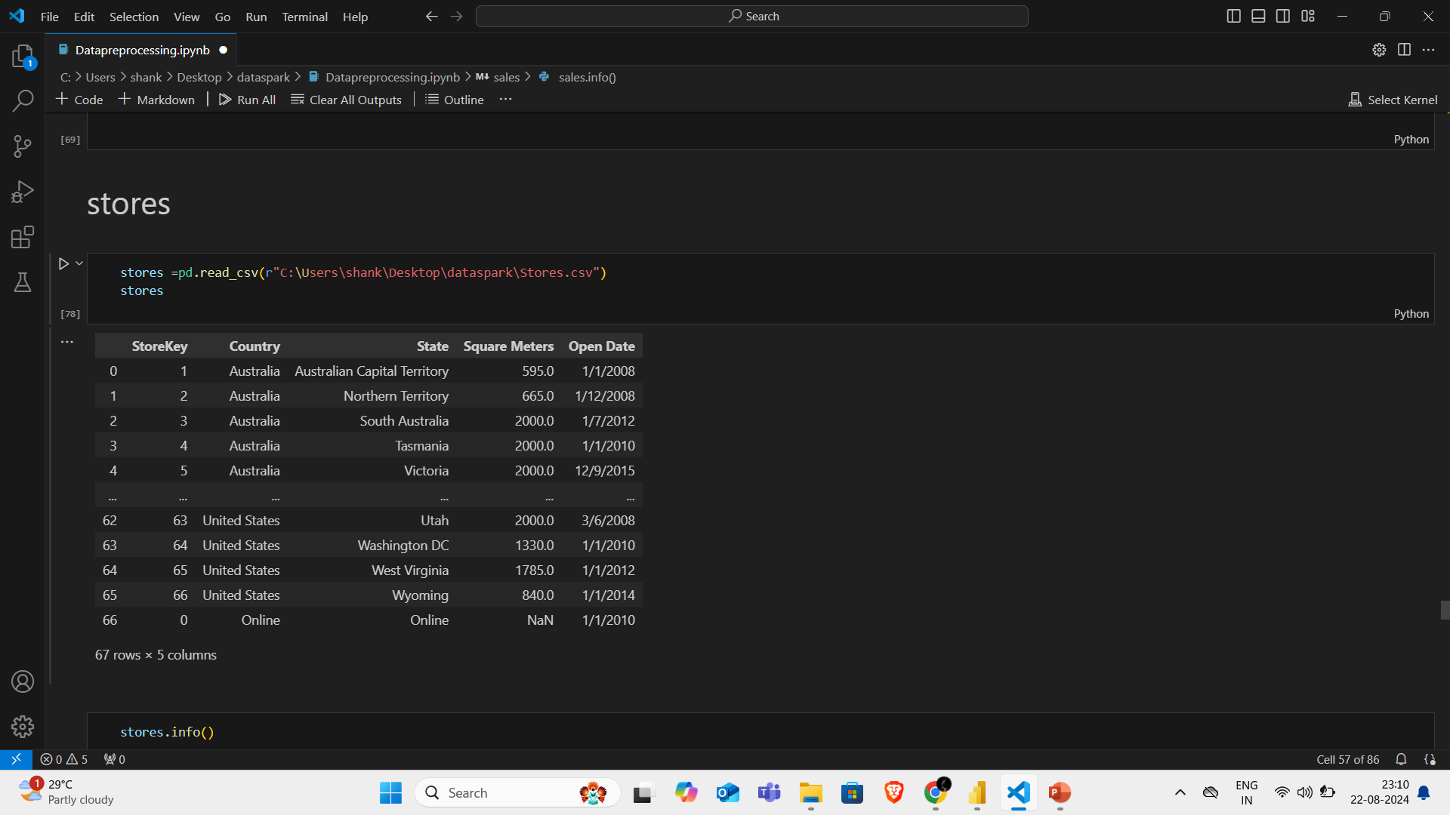
4. Store dataset
It has 5 columns and 67 rows

Slide 21
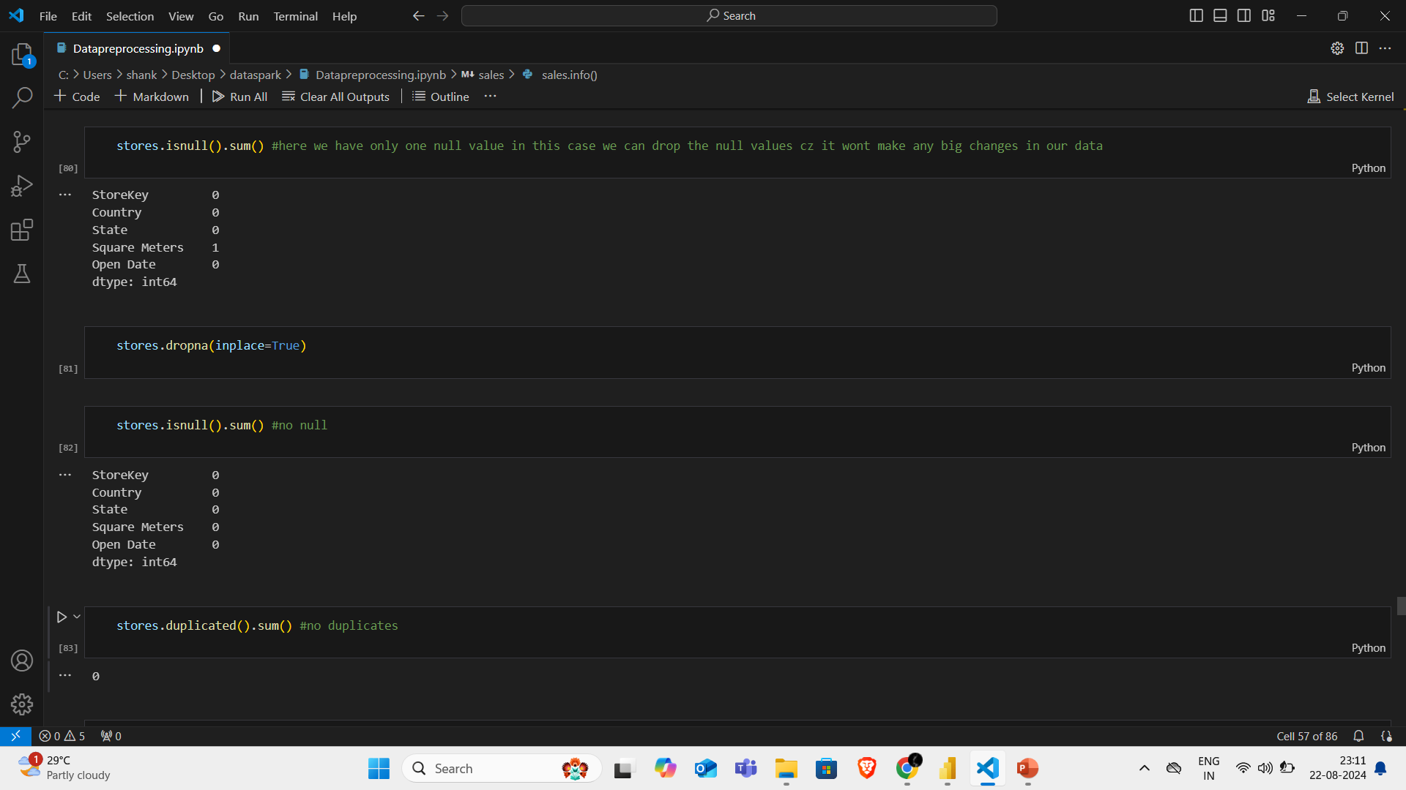
Null & duplicate checking

Slide 22
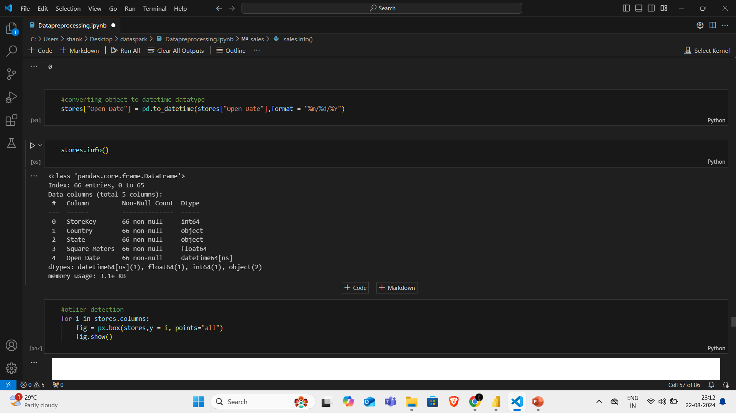
Converting data types

Slide 23
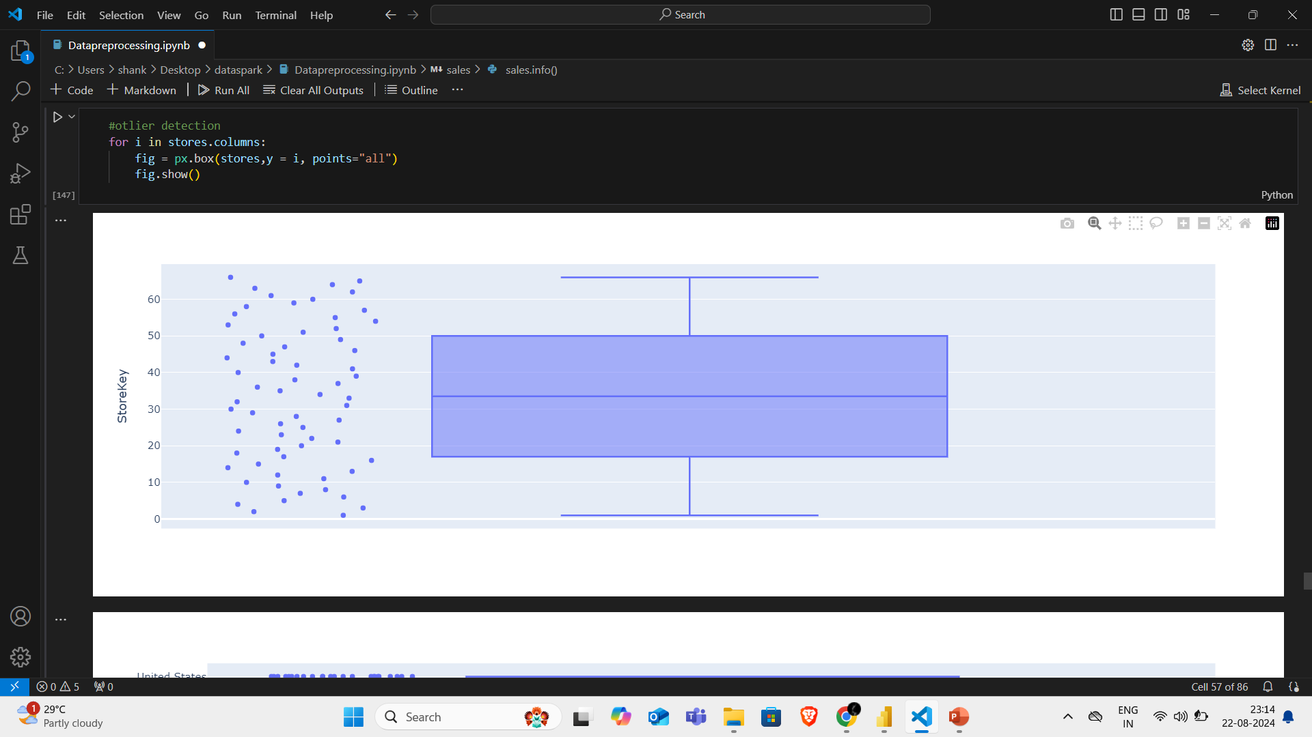
Outlier checking
No treatable outlier in this dataset

Slide 24
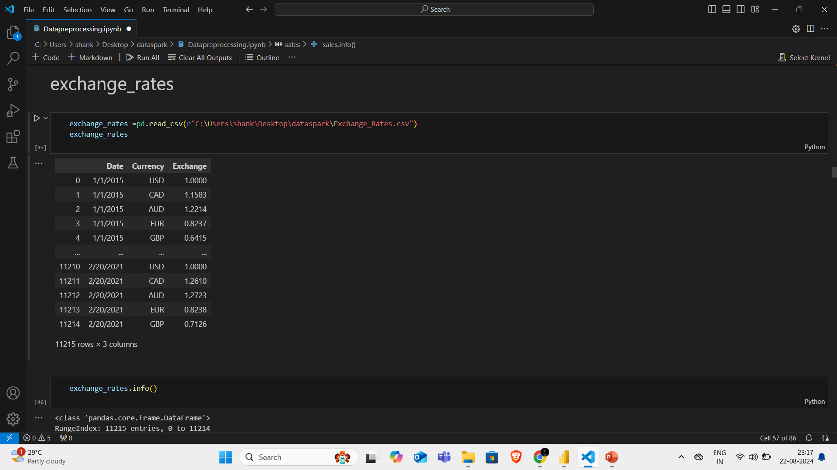
5.Exchange rates dataset
It has 3 columns and 11215 rows

Slide 25
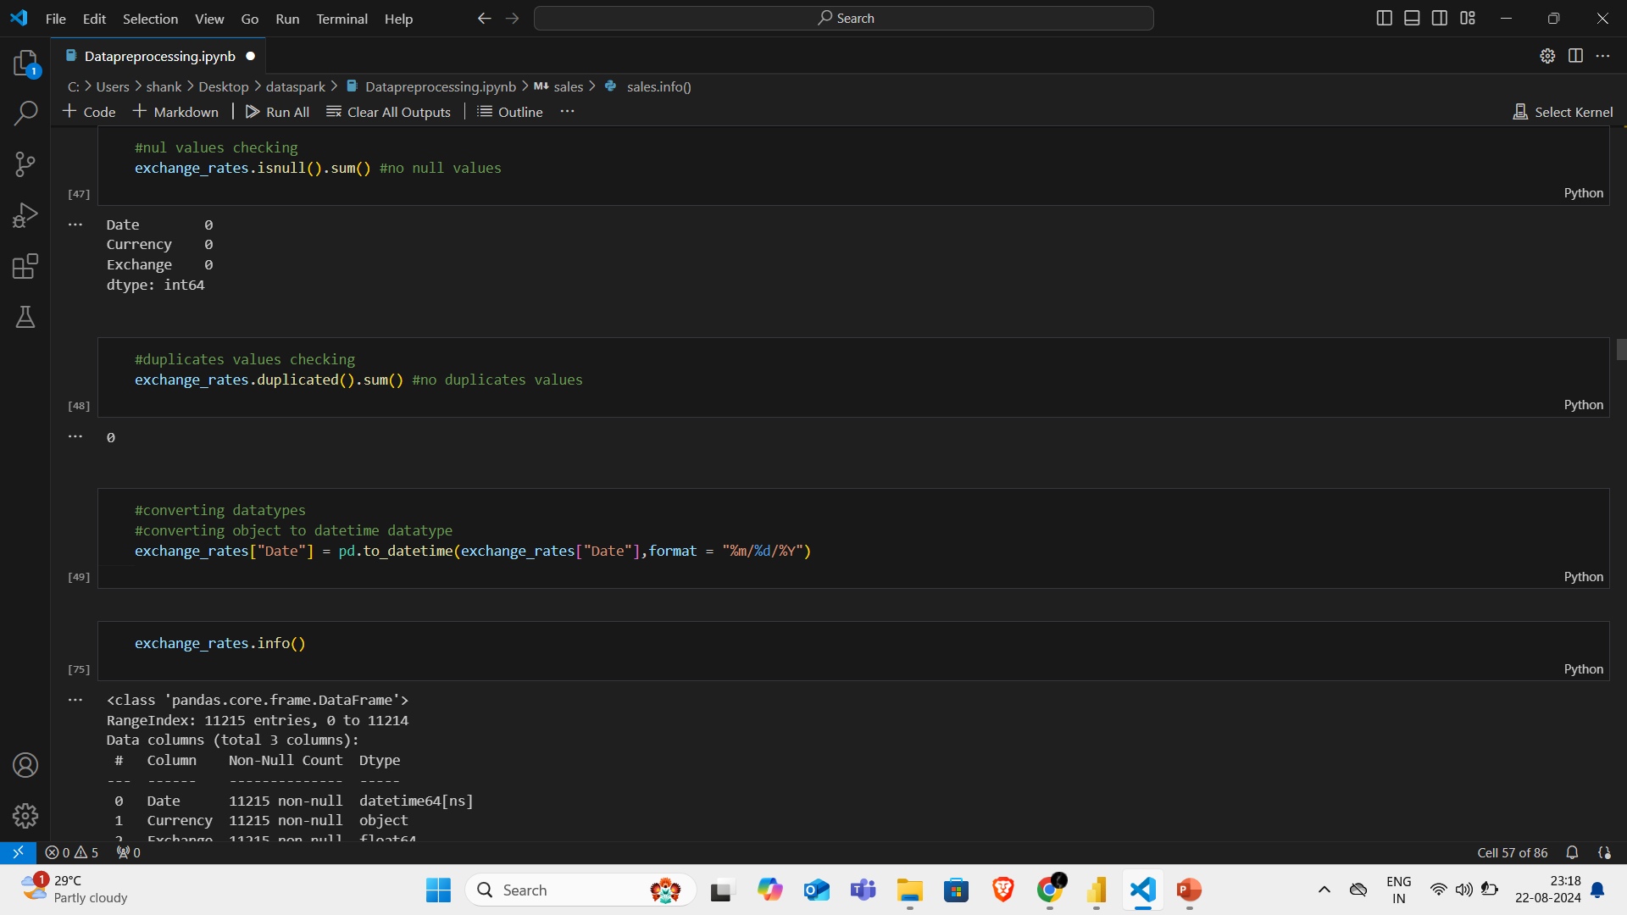
Null,duplicates and dtypes checking
No null and duplicates values
Converted Date column into datetime format

Slide 26
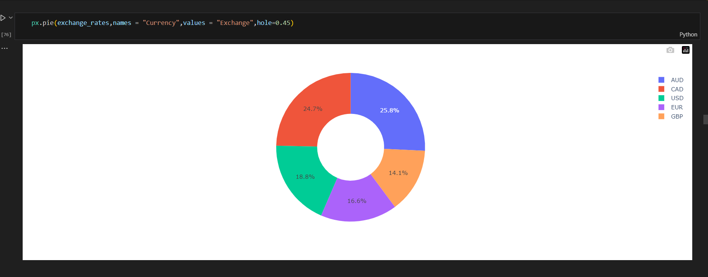
Pie chart
Pie chart to know the relationship

Slide 27
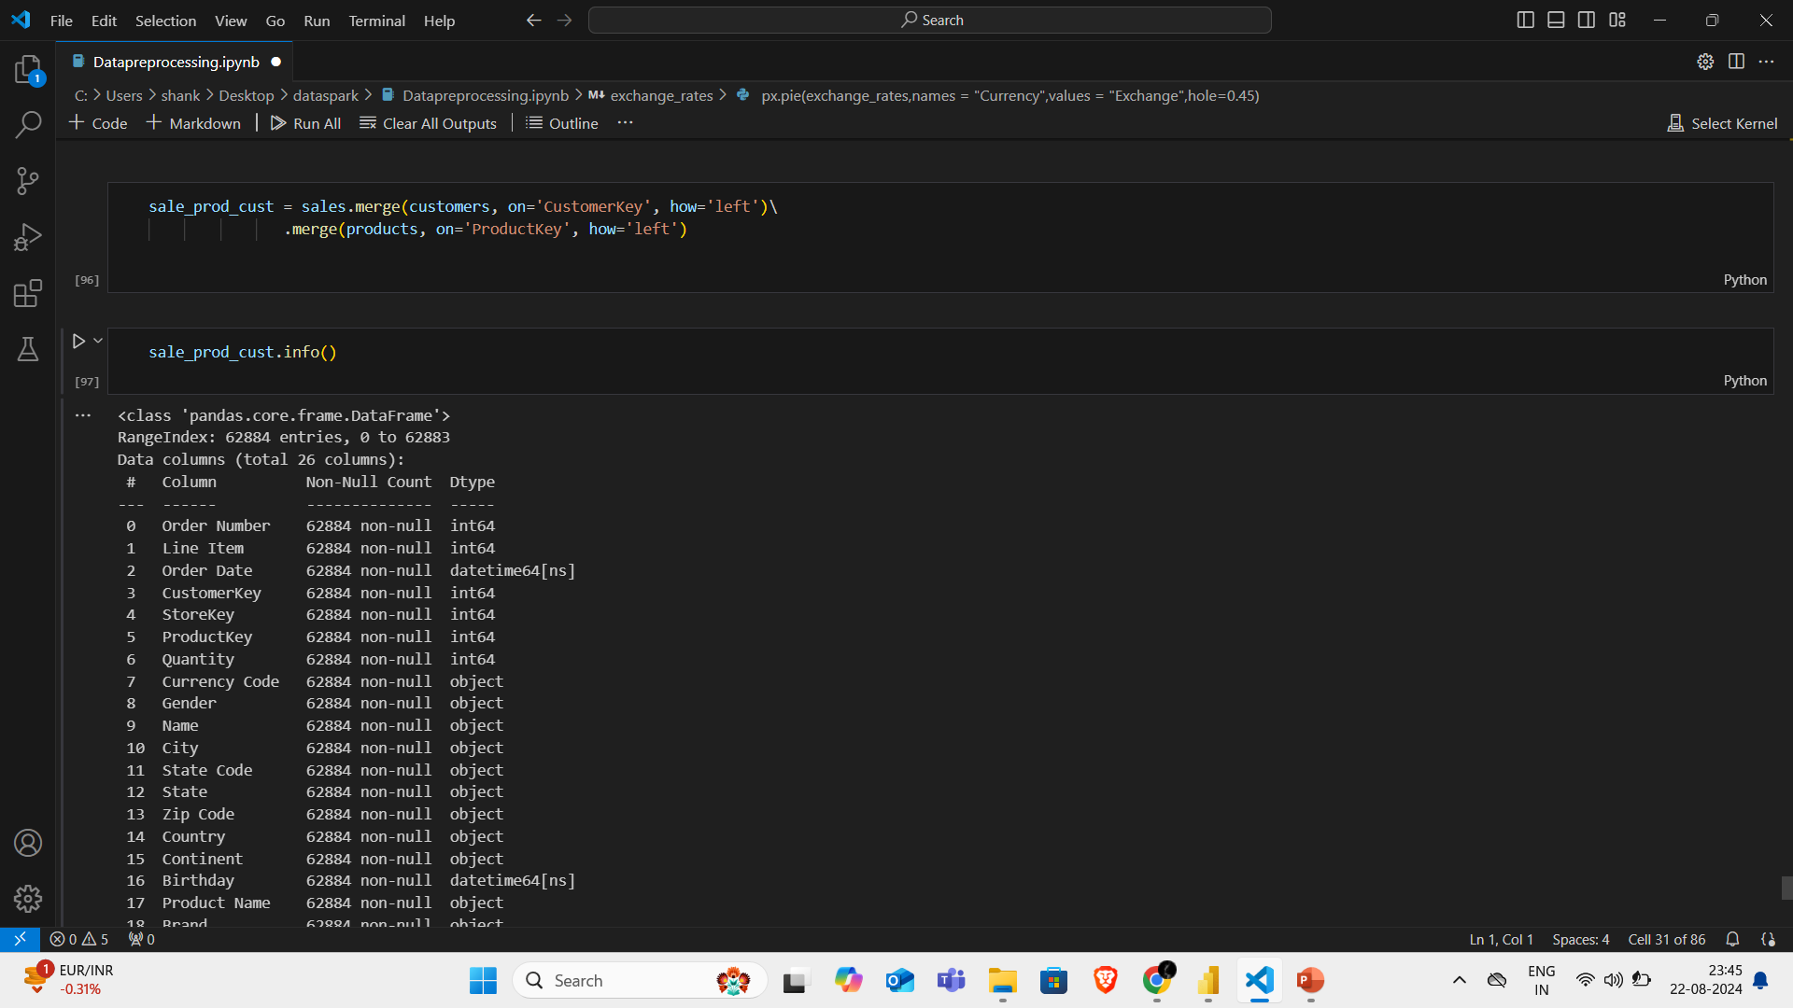
Merging datasets
Merging customer and product table with sales table using their respective unique key

Slide 28
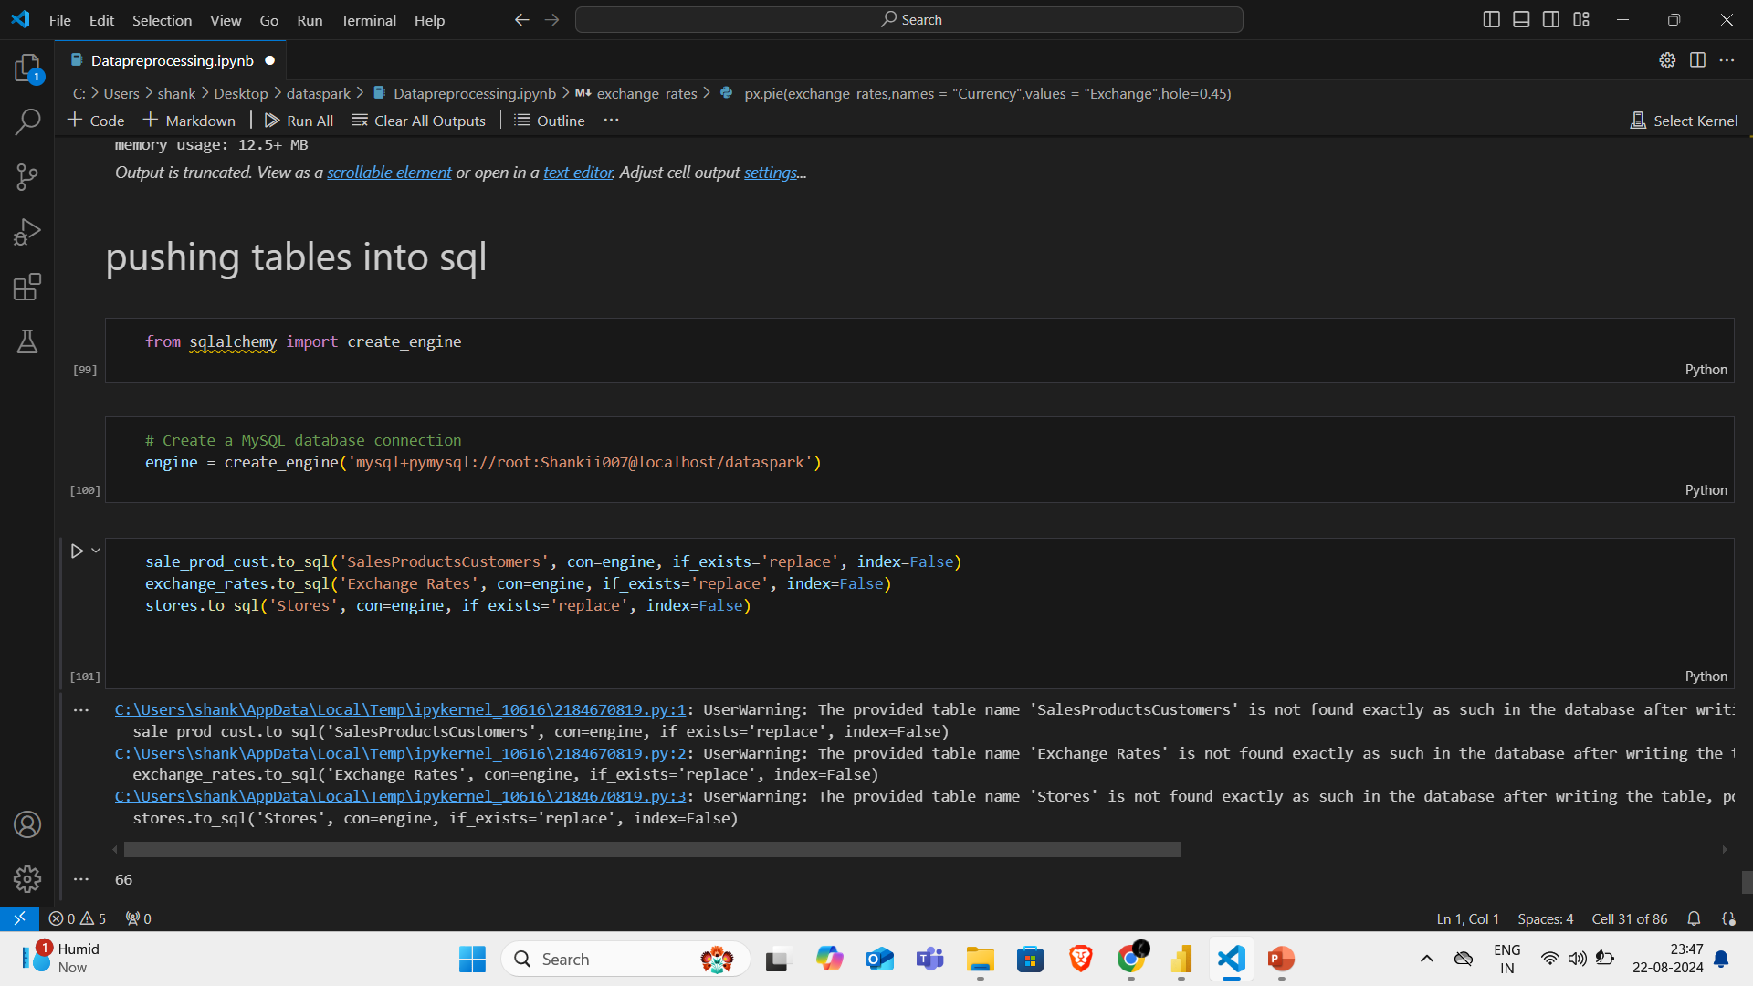
Pushing tables to sql
Pushing the 3 tables into mysql using sqlalchemy

Slide 29
Power BI

Slide 30
Get data
Pushed data from mysql database to power bi by connect mysql data base
After that I transform data sperate 4 different tables from that merged table as per need
Connected the relationship with each of the table with unique key
Then created interactive dashboard for customer,products, sales and stores insight

Slide 31
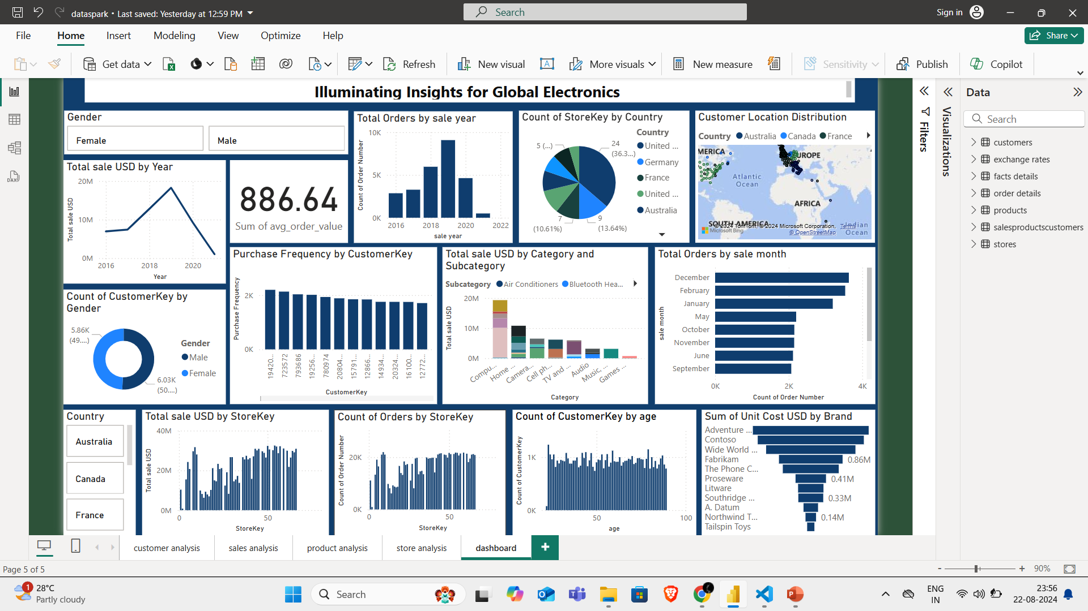
Global electronics insight dashboard

Slide 32
Conclusion
From this dashboard,
Customer wise, product wise,sales wise insight which will help the organization to improve their sales based on the dashboard

Slide 33
Thank You
Submitted by,
Sankari Subbulakshmi

